Slide 1

Master di I livello
Neurofisiologia clinica in area critica e terapia intensiva
Early brain injury after subarachnoid hemorrhage:
a single centre observational study
Michele Romoli
Neurology Unit, Bufalini Hospital, Cesena, IT

Slide 2
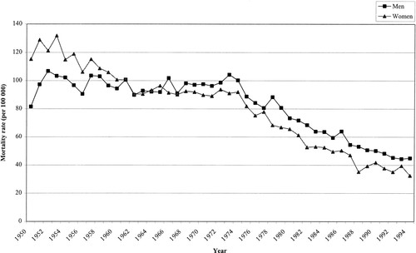
Subarachnoid hemorrhage
SAH is a relatively rare condition (5% of all strokes)
SAH affects mainly young adults (30-60 years), with costs to individuals, caregivers and society
Case fatality had a yearly 0.9% decline over the past two decades
Studies from high-income countries report rates of death as high as 25%
Master di I livello - Neurofisiologia clinica in area critica e terapia intensiva

Slide 3
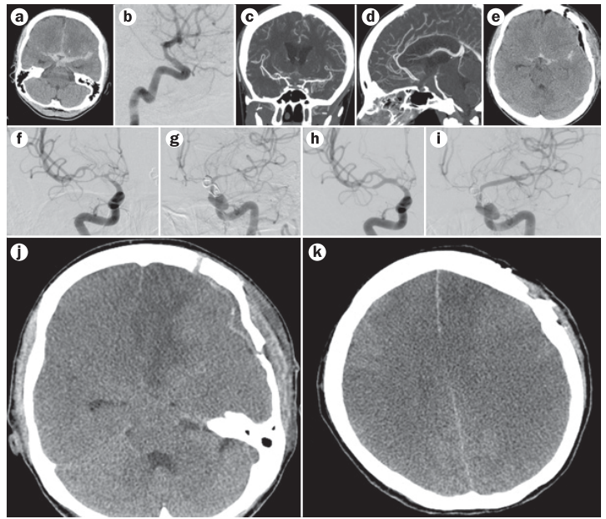
Master di I livello - Neurofisiologia clinica in area critica e terapia intensiva

Slide 4
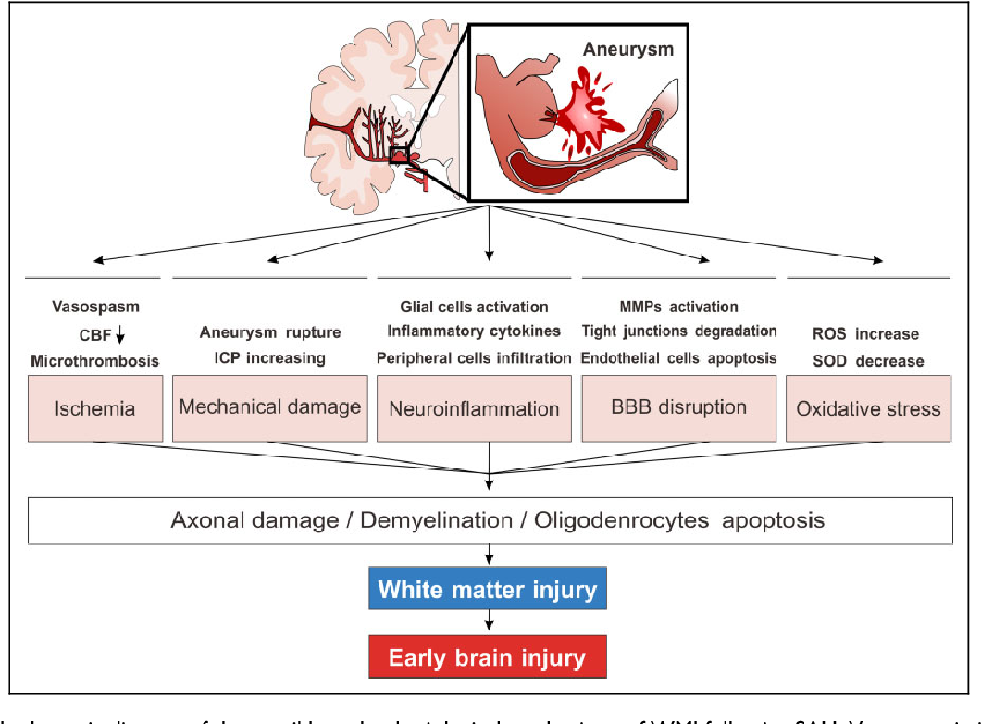
Subarachnoid hemorrhage
Master di I livello - Neurofisiologia clinica in area critica e terapia intensiva

Slide 5
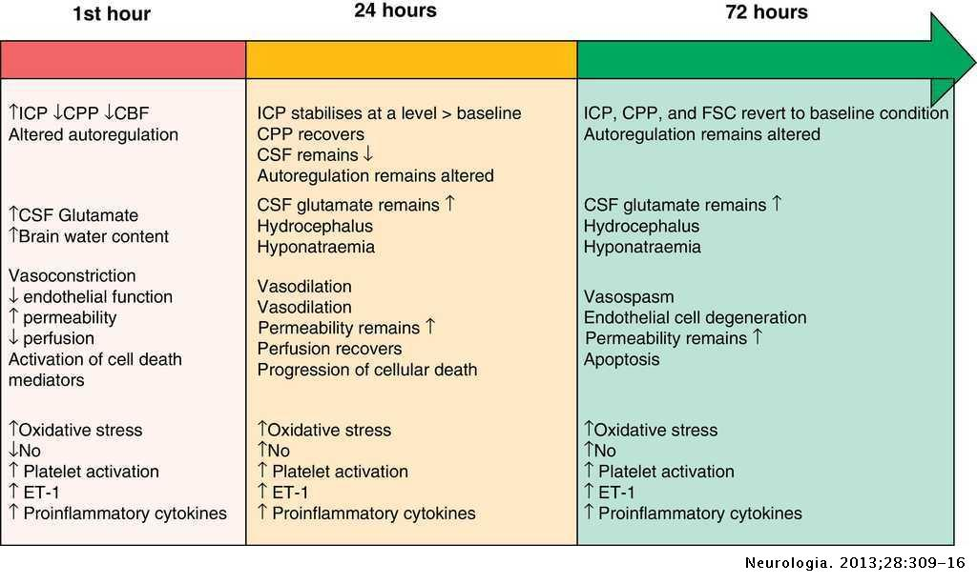
Subarachnoid hemorrhage
Mechanisms of damage extends through time, but happen already in the first 72 hours
Master di I livello - Neurofisiologia clinica in area critica e terapia intensiva

Slide 6
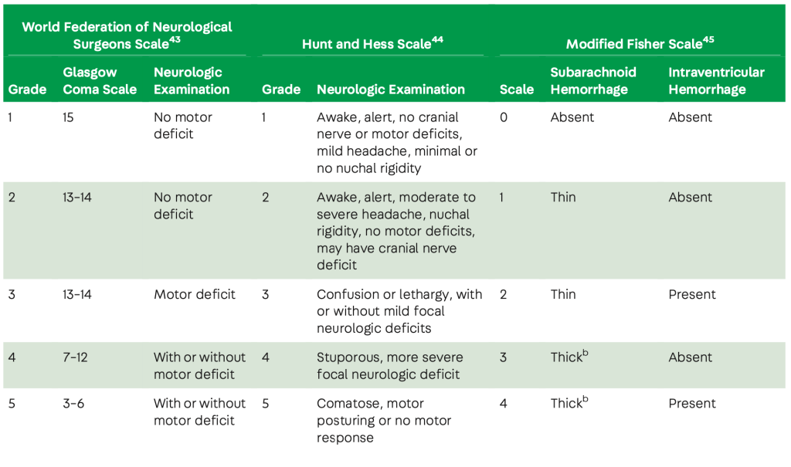
Master di I livello - Neurofisiologia clinica in area critica e terapia intensiva

Slide 7
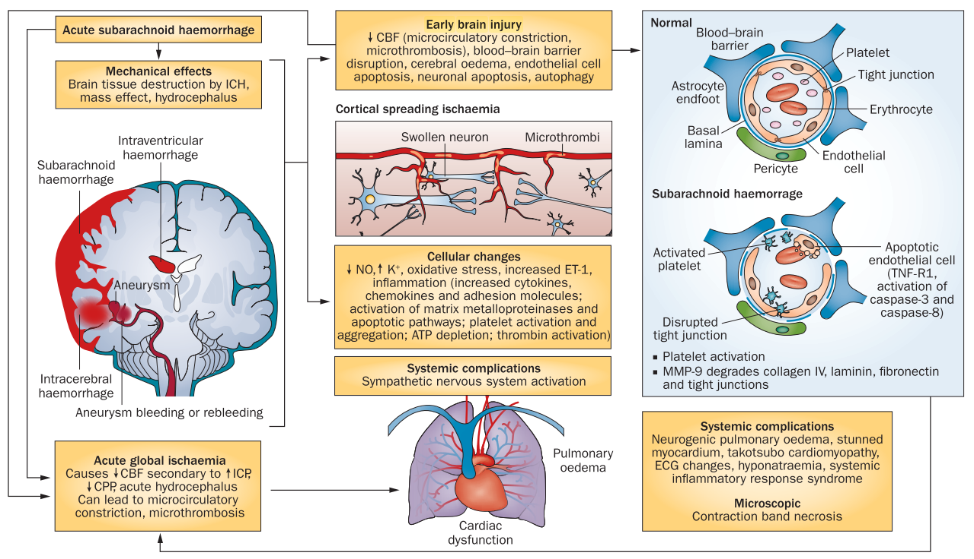
Master di I livello - Neurofisiologia clinica in area critica e terapia intensiva

Slide 8
Delayed and early brain injury
DCI associates with vasospasm,
SAH affects mainly young adults (30-60 years), with costs to individuals, caregivers and society
Case fatality had a yearly 0.9% decline over the past two decades
Studies from high-income countries report rates of death as high as 25%
Master di I livello - Neurofisiologia clinica in area critica e terapia intensiva

Slide 9
Aims
Define the prevalence of Early Brain Injury, seizures and vasospasm
Weight the impact of these factors on the development of EBI and DCI
Master di I livello - Neurofisiologia clinica in area critica e terapia intensiva

Slide 10
Methods
Setting and design:
Retrospective study
Single centre
Cohort:
SAH Patients consecutively admitted to the Bufalini Hospital
Timeframe 2019-2020
GCS<13 at presentation & modified Fischer scale ≥2
SAH undergoing neurosurgical or endovascular treatment for rebleeding prevention
Master di I livello - Neurofisiologia clinica in area critica e terapia intensiva

Slide 11
Methods
Data collection:
Demographic
Brain CT scan at baseline, 24h, 48h, 72h and first ischemia up to 30 days after SAH
EEG recordings in the first 72 hours
TCD daily findings
Definition:
Early brain injury (EBI): any ischemia, evolving edema or new bleeding developing in the first 72 hours
Delayed cerebral ischemia (DCI): ischemia developing later than 72 hours
Master di I livello - Neurofisiologia clinica in area critica e terapia intensiva

Slide 12
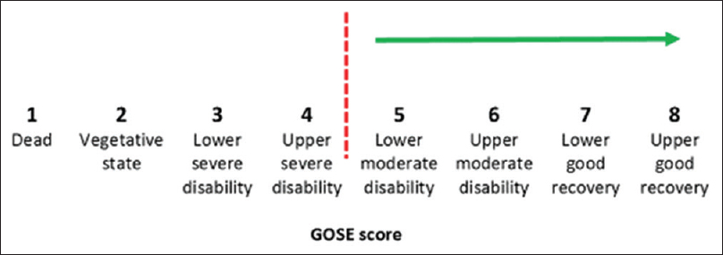
Outcomes
Primary: Functional recovery = GOSE score of 5 or higher
Secondary: any ischemia, early brain injury, overt seizures and epileptic activity, and vasospasm.
Master di I livello - Neurofisiologia clinica in area critica e terapia intensiva

Slide 13
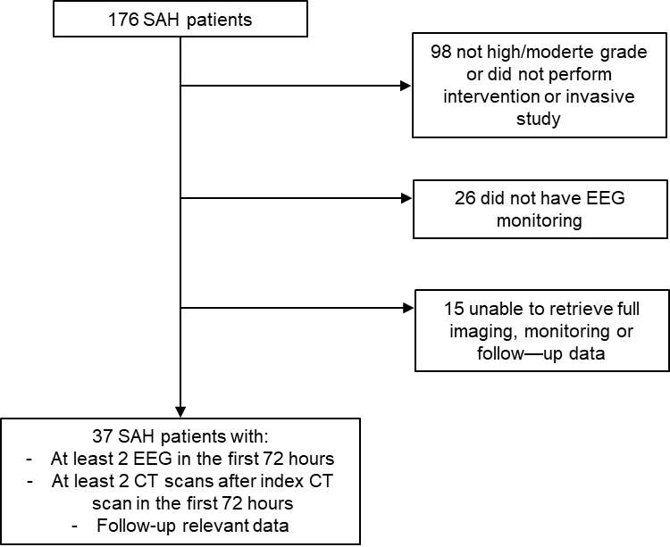
Results - I
Master di I livello - Neurofisiologia clinica in area critica e terapia intensiva

Slide 14
Cohort (n=37)
Age | 56.1 ± 14
Gender (female) | 23 (62.2%)
Smoking | 11 (29.7%)
Hypertension | 20 (54.1%)
Diabetes | 2 (5.4%)
WFNS | 3 ± 1.6
Hunt-Hess | 3.6 ± 1.3
GCS | 9.9 ± 4.5
modified Fischer scale | 3.6 ± 0.8
Interventional approach | 1 (2.7%)
EVT | 18 (48.6%)
Time to intervention | 0 ± 0
Hydrocephalus | 23 (62.2%)
External ventriculr drainage | 23 (62.2%)
Intracranial hypertension (0-24h) | 12 (32.4%)
Intracranial hypertension (>24h) | 9 (24.3%)
Non-infective fever | 26 (70.3%)
Hyponatriemia | 17 (45.9%)
Therapeutic hypertension | 11 (29.7%)
ICH | 16 (43.2%)
SAH site
infratentorial | 2 (5.4%)
left-sided | 8 (21.6%)
pancisternal | 19 (51.4%)
right-sided | 8 (21.6%)
Results - II
37 patients
Full data on long-term outcomes and clinical and neuroradiological variables
Master di I livello - Neurofisiologia clinica in area critica e terapia intensiva

Slide 15
Outcome data
GOSE 12 months | 4.6 ± 2.7
Good recovery (GOSE 7-8) | 13 (35.1%)
Favorable outcome (GOSE>4) | 18 (48.6%)
EQOL-Index | 0.6 ± 0.5
EQOL-VAS | 74.6 ± 21
Early brain ischemia (<72h) | 19 (51.4%)
Clinical deterioration | 6 (16.2%)
Any ischemia | 25 (67.6%)
Time to ischemia | 12.1 ± 12.8
Symptomatic ischemic lesion | 17 (68%)
Asymptomatic ischemic lesion | 8 (32%)
Ischemia volume (largest, ml) | 44.5 ± 59.7
Vasospasm
mild | 4 (10.8%)
moderate | 4 (10.8%)
severe | 7 (18.9%)
Recurrent vasospasm | 2 (11.8%)
Prophylaxis or ASM before EEG | 28 (75.7%)
Overt seizures | 5 (13.5%)
Epileptic activity (either overt seizures, NCSE or Electrical activity) | 29 (78.4%)
NCSE | 5 (13.5%)
definite | 2 (5.4%)
possible | 3 (8.1%)
Endovascular rescue therapy | 2 (5.4%)
ICU stay (days) | 14.4 ± 7.2
Hospital stay (days) | 29.7 ± 25.9
Results - II
Master di I livello - Neurofisiologia clinica in area critica e terapia intensiva

Slide 16
Results - IV
EBI distribution according to Hunt-Hess scale
Master di I livello - Neurofisiologia clinica in area critica e terapia intensiva

Slide 17
Results - V
 | no EBI (n=18) | EBI (n=19) | p-value
Age | 60 ± 12.3 | 53 ± 14.9 | ns
Gender | 12 (66.7%) | 11 (57.9%) | ns
Smoking | 6 (33.3%) | 5 (26.3%) | ns
Hypertension | 11 (61.1%) | 9 (47.4%) | ns
Diabetes | 2 (11.1%) | 0 (0%) | ns
WFNS | 2.4 ± 1.6 | 3.6 ± 1.4 | ns
Hunt-Hess | 3.1 ± 1.2 | 4 ± 1.2 | ns
GCS | 11.3 ± 4.2 | 8.5 ± 4.4 | ns
modified Fischer scale | 3.3 ± 0.9 | 3.9 ± 0.5 | ns
Endovascular approach | 12 (66.7%) | 6 (31.6%) | 0.038
Time to intervention | 0 ± 0 | 0 ± 0 | ns
Hydrocephalus | 11 (61.1%) | 12 (63.2%) | ns
External ventriculr drainage | 11 (61.1%) | 12 (63.2%) | ns
Intracranial hypertension (0-24h) | 2 (11.1%) | 10 (52.6%) | 0.016
Intracranial hypertension >24h) | 3 (16.7%) | 6 (31.6%) | ns
Non-infective fever | 10 (55.6%) | 16 (84.2%) | ns
Hyponatriemia | 7 (38.9%) | 10 (52.6%) | ns
Therapeutic hypertension | 3 (16.7%) | 8 (42.1%) | ns
ICH | 5 (27.8%) | 11 (57.9%) | ns
SAH site |  |  | ns
infratenetorial | 2 (11.1%) | 0 (0%) | ns
left | 3 (16.7%) | 5 (26.3%) | ns
pancisternal | 9 (50%) | 10 (52.6%) | ns
right | 4 (22.2%) | 4 (21.1%) | ns
Endovascular rescue therapy | 2 (11.1%) | 0 (0%) | ns

Slide 18
Results - VI
 | no EBI (n=18) | EBI (n=19) | p-value
Age | 60 ± 12.3 | 53 ± 14.9 | ns
Gender | 12 (66.7%) | 11 (57.9%) | ns
Smoking | 6 (33.3%) | 5 (26.3%) | ns
Hypertension | 11 (61.1%) | 9 (47.4%) | ns
Diabetes | 2 (11.1%) | 0 (0%) | ns
WFNS | 2.4 ± 1.6 | 3.6 ± 1.4 | ns
Hunt-Hess | 3.1 ± 1.2 | 4 ± 1.2 | ns
GCS | 11.3 ± 4.2 | 8.5 ± 4.4 | ns
modified Fischer scale | 3.3 ± 0.9 | 3.9 ± 0.5 | ns
Endovascular approach | 12 (66.7%) | 6 (31.6%) | 0.038
Time to intervention | 0 ± 0 | 0 ± 0 | ns
Hydrocephalus | 11 (61.1%) | 12 (63.2%) | ns
External ventriculr drainage | 11 (61.1%) | 12 (63.2%) | ns
Intracranial hypertension (0-24h) | 2 (11.1%) | 10 (52.6%) | 0.016
Intracranial hypertension >24h) | 3 (16.7%) | 6 (31.6%) | ns
Non-infective fever | 10 (55.6%) | 16 (84.2%) | ns
Hyponatriemia | 7 (38.9%) | 10 (52.6%) | ns
Therapeutic hypertension | 3 (16.7%) | 8 (42.1%) | ns
ICH | 5 (27.8%) | 11 (57.9%) | ns
SAH site |  |  | ns
infratenetorial | 2 (11.1%) | 0 (0%) | ns
left | 3 (16.7%) | 5 (26.3%) | ns
pancisternal | 9 (50%) | 10 (52.6%) | ns
right | 4 (22.2%) | 4 (21.1%) | ns
Endovascular rescue therapy | 2 (11.1%) | 0 (0%) | ns

Slide 19
Results - VII
Outcomes | no EBI (n=18) | EBI (n=19)
GOSE 12 months | 5 ± 2.6 | 4 ± 2.7 | ns
Good recovery (GOSE 7-8) | 9 (50%) | 4 (21.1%) | ns
Favorable outcome (GOSE>4) | 12 (66.7%) | 6 (31.6%) | ns
EQOL-Index | 0.6 ± 0.5 | 0.5 ± 0.5 | ns
EQOL-VAS | 75 ± 25.4 | 74 ± 14 | ns
ICU stay (days) | 13 ± 8.8 | 16 ± 4.8 | ns
Hospital stay (days) | 25 ± 18.1 | 34 ± 31.5 | ns
Clinical deterioration (New focal neurological deficit OR GCS 2 points OR NIHSS 2 points) | 2 (11.1%) | 4 (21.1%) | ns
Any ischemia | 6 (33.3%) | 19 (100%) | ns
Symptomatic ischemic lesion | 2 (33.3%) | 15 (78.9%) | ns
Vasospasm | 5 (27.8%) | 10 (52.6%) | ns
Vasospasm grading |  |  | ns
mild | 3 (16.7%) | 1 (5.3%) | ns
moderate | 1 (5.6%) | 3 (15.8%) | ns
severe | 1 (5.6%) | 6 (31.6%) | ns
Recurrent vasospasm | 2 (40%) | 0 (0%) | ns
Prophylaxis or ASM before EEG | 10 (55.6%) | 18 (94.7%) | 0.005
Overt seizures | 3 (16.7%) | 2 (10.5%) | ns
Epileptic activity (either overt seizures, NCSE or Electrical activity) | 12 (66.7%) | 17 (89.5%) | ns
NCSE |  |  | ns
definite | 2 (11.1%) | 0 (0%) | ns
possible | 2 (11.1%) | 1 (5.3%) | ns

Slide 20
Results - VII
Outcomes | no EBI (n=18) | EBI (n=19)
GOSE 12 months | 5 ± 2.6 | 4 ± 2.7 | ns
Good recovery (GOSE 7-8) | 9 (50%) | 4 (21.1%) | ns
Favorable outcome (GOSE>4) | 12 (66.7%) | 6 (31.6%) | ns
EQOL-Index | 0.6 ± 0.5 | 0.5 ± 0.5 | ns
EQOL-VAS | 75 ± 25.4 | 74 ± 14 | ns
ICU stay (days) | 13 ± 8.8 | 16 ± 4.8 | ns
Hospital stay (days) | 25 ± 18.1 | 34 ± 31.5 | ns
Clinical deterioration (New focal neurological deficit OR GCS 2 points OR NIHSS 2 points) | 2 (11.1%) | 4 (21.1%) | ns
Any ischemia | 6 (33.3%) | 19 (100%) | ns
Symptomatic ischemic lesion | 2 (33.3%) | 15 (78.9%) | ns
Vasospasm | 5 (27.8%) | 10 (52.6%) | ns
Vasospasm grading |  |  | ns
mild | 3 (16.7%) | 1 (5.3%) | ns
moderate | 1 (5.6%) | 3 (15.8%) | ns
severe | 1 (5.6%) | 6 (31.6%) | ns
Recurrent vasospasm | 2 (40%) | 0 (0%) | ns
Prophylaxis or ASM before EEG | 10 (55.6%) | 18 (94.7%) | 0.005
Overt seizures | 3 (16.7%) | 2 (10.5%) | ns
Epileptic activity (either overt seizures, NCSE or Electrical activity) | 12 (66.7%) | 17 (89.5%) | ns
NCSE |  |  | ns
definite | 2 (11.1%) | 0 (0%) | ns
possible | 2 (11.1%) | 1 (5.3%) | ns

Slide 21
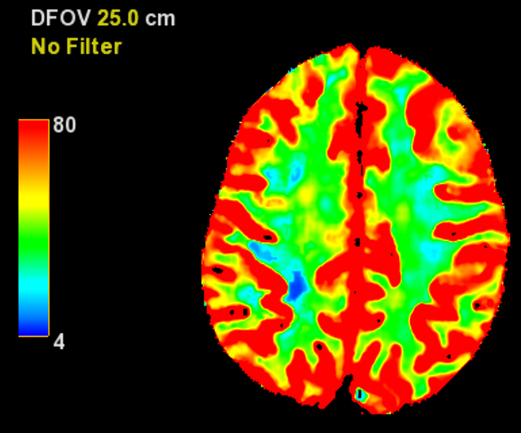
Master di I livello - Neurofisiologia clinica in area critica e terapia intensiva

Slide 22
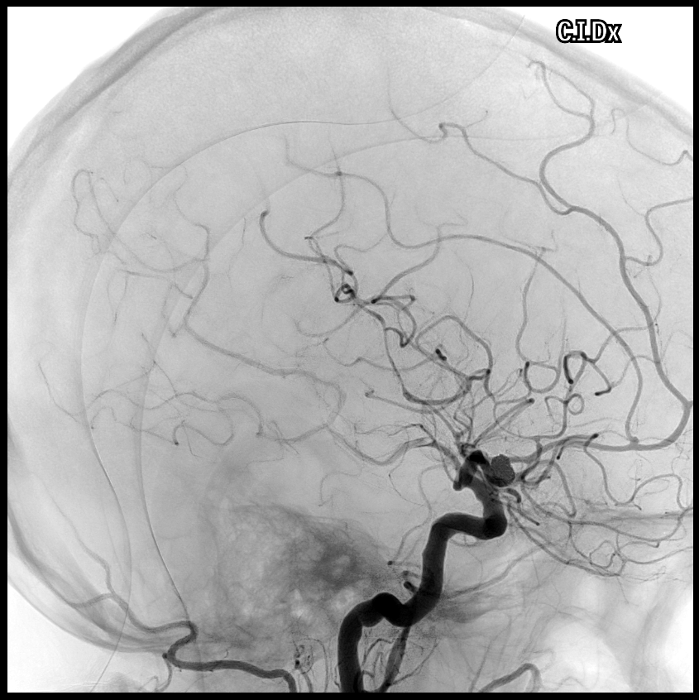
Master di I livello - Neurofisiologia clinica in area critica e terapia intensiva

Slide 23
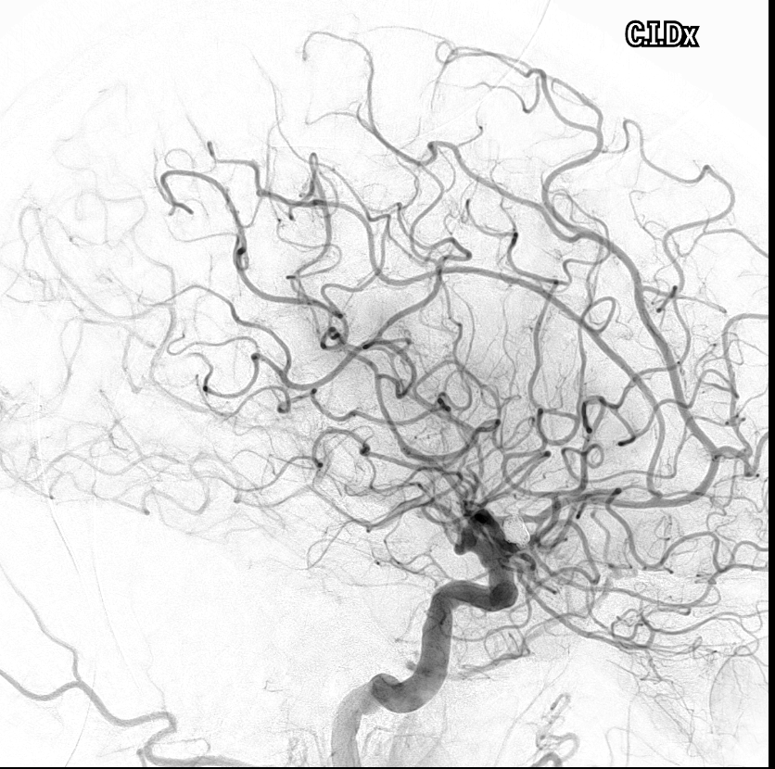
Master di I livello - Neurofisiologia clinica in area critica e terapia intensiva

Slide 24
Master di I livello - Neurofisiologia clinica in area critica e terapia intensiva

Slide 25
Results
 | GOSE 1-4 (n=19) | GOSE 5-8 (n=18) | p-value
Age | 55 ± 16.9 | 57 ± 10.5 | ns
Gender | 10 (52.6%) | 13 (72.2%) | ns
Smoking | 7 (36.8%) | 4 (22.2%) | ns
Hypertension | 9 (47.4%) | 11 (61.1%) | ns
Diabetes | 0 (0%) | 2 (11.1%) | ns
WFNS | 3.4 ± 1.6 | 2.6 ± 1.5 | ns
Hunt-Hess | 4 ± 1.2 | 3.1 ± 1.1 | 0.022
GCS | 8.8 ± 4.9 | 11.1 ± 3.8 | ns
modified Fischer scale | 3.8 ± 0.6 | 3.4 ± 0.9 | ns
Intracranial hypertension (0-24h) | 10 (52.6%) | 2 (11.1%) | 0.007
Hyponatriemia | 10 (52.6%) | 7 (38.9%) | ns
Therapeutic hypertension | 6 (31.6%) | 5 (27.8%) | ns
ICH | 11 (57.9%) | 5 (27.8%) | 0.05
Endovascular rescue therapy | 0 (0%) | 2 (11.1%) | ns
Master di I livello - Neurofisiologia clinica in area critica e terapia intensiva

Slide 26
Results
Outcomes | GOSE 1-4 (n=19) | GOSE 5-8 (n=18) | p-value
EQOL-Index | 0.1 ± 0.5 | 0.8 ± 0.3 | <0.001
EQOL-VAS | 54 ± 23.3 | 84 ± 11.5 | <0.001
ICU stay (days) | 17 ± 5.1 | 12 ± 8.2 | 0.032
Hospital stay (days) | 34 ± 33.7 | 26 ± 13.6 | ns
Early brain ischemia (<72h) | 13 (68.4%) | 6 (33.3%) | 0.033
Any ischemia | 15 (78.9%) | 10 (55.6%) | ns
Symptomatic ischemic lesion | 12 (80%) | 5 (50%) | ns
Vasospasm grading |  |  | ns
mild | 2 (10.5%) | 2 (11.1%) | ns
moderate | 2 (10.5%) | 2 (11.1%) | ns
severe | 5 (26.3%) | 2 (11.1%) | ns
Recurrent vasospasm | 0 (0%) | 2 (28.6%) | 0.072
Clinical deterioration (New focal neurological deficit OR GCS 2 points OR NIHSS 2 points) | 3 (15.8%) | 3 (16.7%) | ns
Prophylaxis or ASM before EEG | 14 (73.7%) | 14 (77.8%) | ns
Overt seizures | 3 (15.8%) | 2 (11.1%) | ns
Epileptic activity (either overt seizures, NCSE or Electrical activity) | 15 (78.9%) | 14 (77.8%) | ns
NCSE
definite | 1 (5.3%) | 1 (5.6%) | ns
possible | 2 (10.5%) | 1 (5.6%) | ns

Slide 27
Results
Logistic regression for good functional outcome
Factor | OR (95%CI)
Age | 0.98 (0.91-1.06)
Overt seizures | 0.4 (0.04-3.85)
Hunt-Hess | 0.55 (0.27-1.09)
ICH | 0.32 (0.06-1.78)
Early brain ischemia (<72h) | 0.28 (0.05-1.51)
Vasospasm | 1.04 (0.14-7.67)
Master di I livello - Neurofisiologia clinica in area critica e terapia intensiva

Slide 28
Master di I livello - Neurofisiologia clinica in area critica e terapia intensiva

Slide 29
Master di I livello - Neurofisiologia clinica in area critica e terapia intensiva

Slide 30
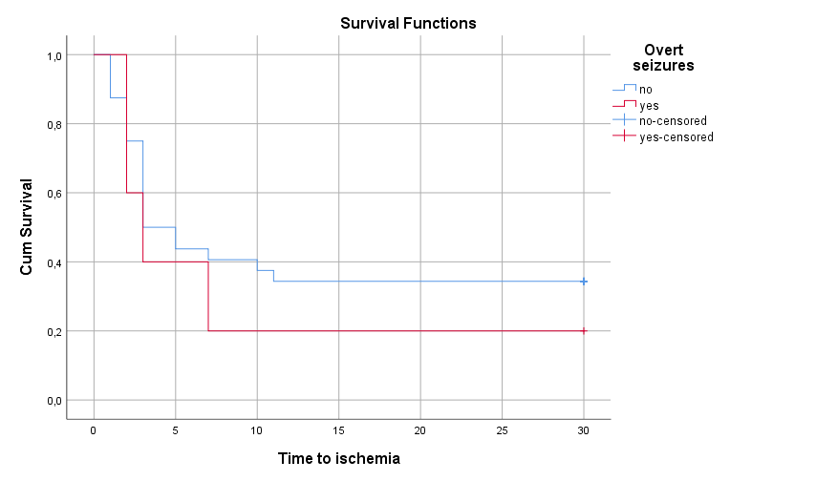
Results
Time to ischemia depending on the overt seizure

Slide 31
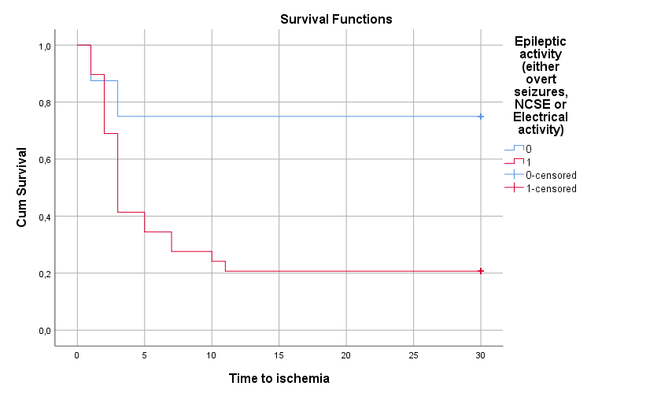
Results
Time to ischemia depending on epileptic activity
LogRank p=0.01

Slide 32
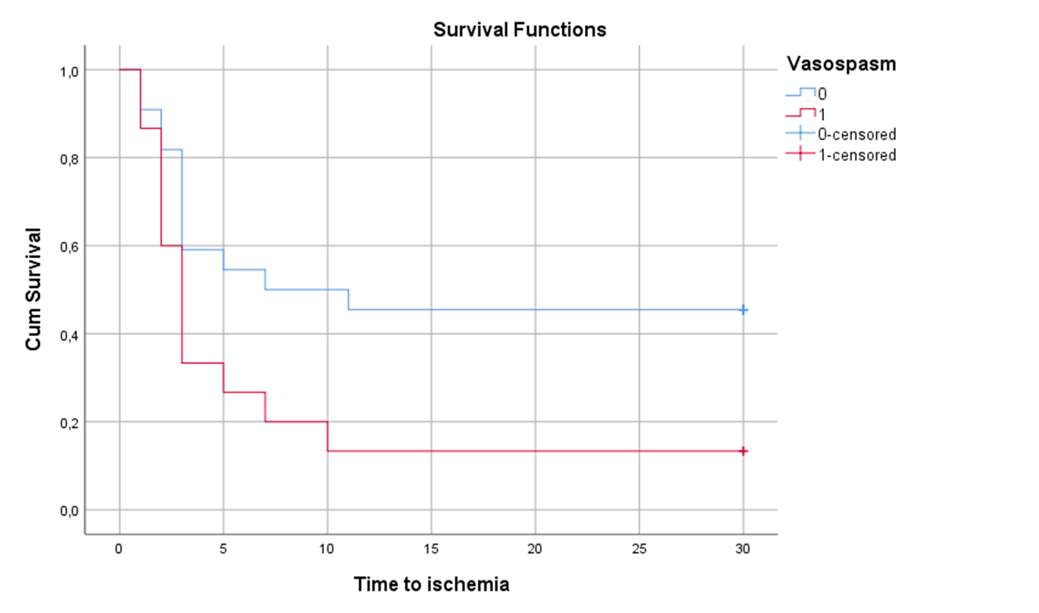
Results
Time to ischemia depending on the development of vasospasm
LogRank p=0.013

Slide 33
Conclusions
Early brain ischemia (<72h)
Happens in half of SAH cases
Risk factors for EBI largely uncertain – no critical predictor, but 90% has some epileptic activity
Overt seizures
In 13.5% of SAH cases
NCSE
In 13.5% of SAH cases
When considering whole epileptic activity in the first 72 hours after SAH the estimate reaches 70% → justifies early monitoring

Slide 34

Conclusions
EBI can have an influence on the long term recovery from SAH
EBI reduces the chances of good functional recovery by 70% on overall estimates
The onset of any ischemia seems favoured in the acute and subacute term (30 days from SAH) by epileptic activity
Q: antiseizure prevention has global effect on EBI?

Slide 35
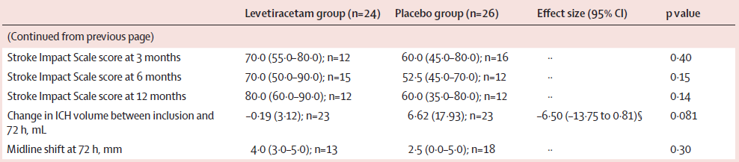
Conclusions
EBI can have an influence on the long term recovery from SAH
EBI reduces the chances of good functional recovery by 70% on overall estimates
The onset of any ischemia seems favoured in the acute and subacute term (30 days from SAH) by epileptic activity
Q: antiseizure prevention has global effect on EBI?
PEACH trial - Levetiracetam might be effective in preventing acute seizures in intracerebral haemorrhage + hematoma expansion

